Slide 1
Image Captioning System
General Assembly DSI-10 2019 Capstone
Kelvin Kong

Slide 2
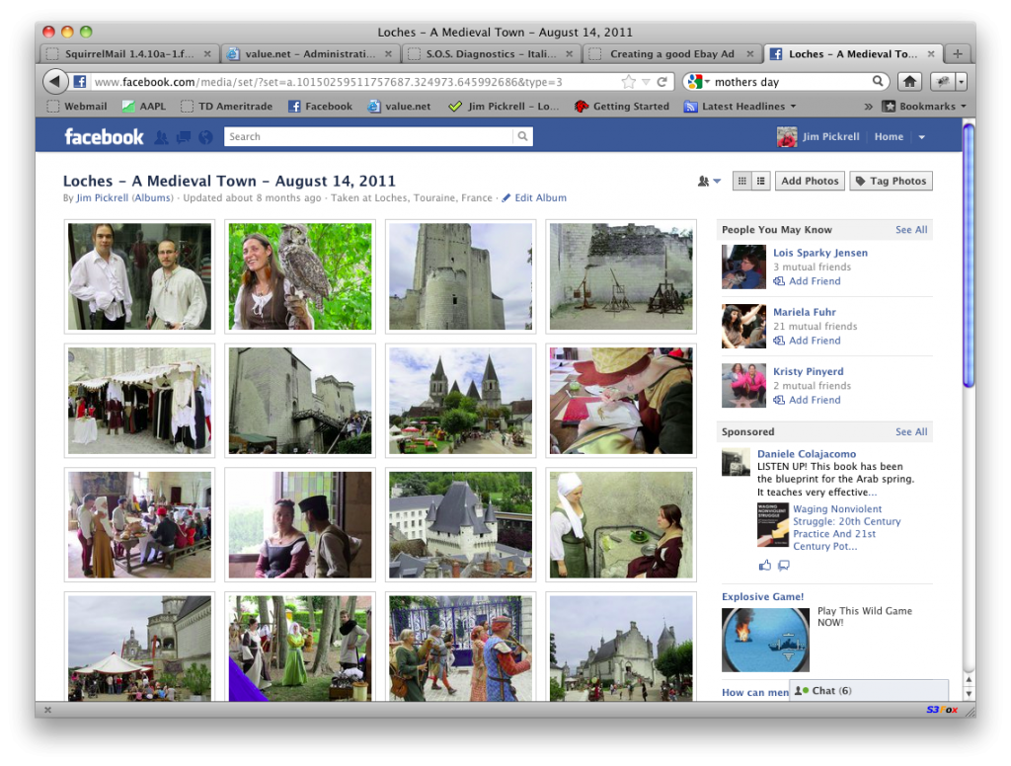
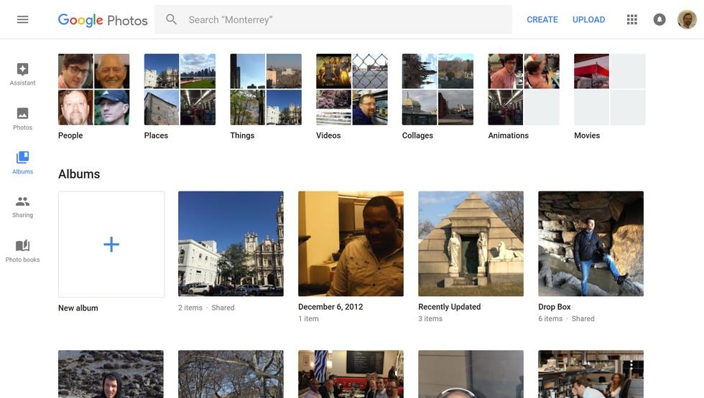
Problem Statement
With an onslaught of photos on the web today:
350 Million photos uploaded daily on FB
1.2 billion photos uploaded to Google Photos daily
It is challenge to search across all these photos because most photos are not tagged with keywords.
Without specific keywords being associated to the photos, the photos are not searchable.

Slide 3
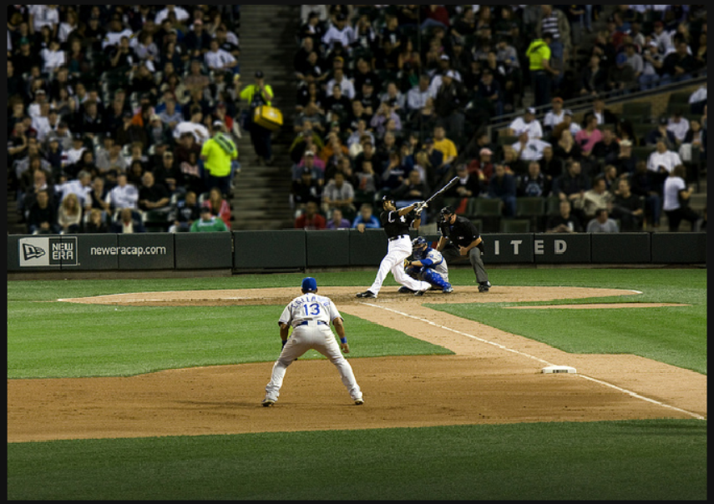
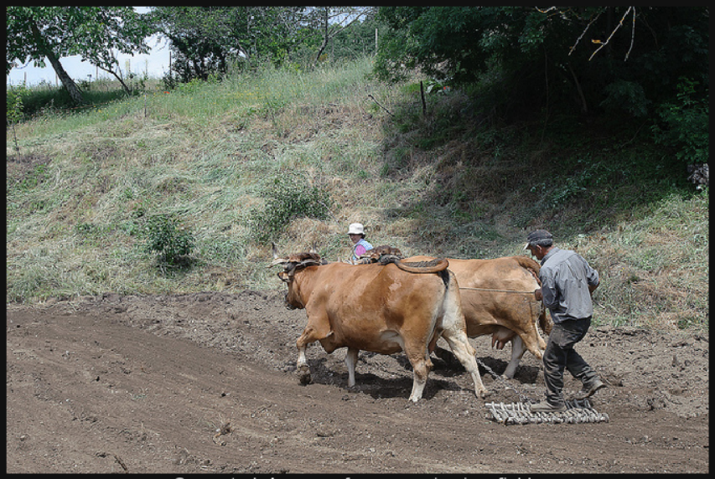
Data Science Problem
Build a model that could automatically describe any image that is given to it.
The model is to:
Take in an image of any size and dimension as input
Output a human readable sentence that describes what is in the image

Slide 4
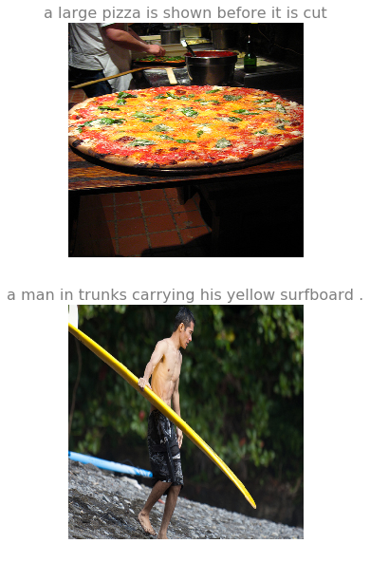
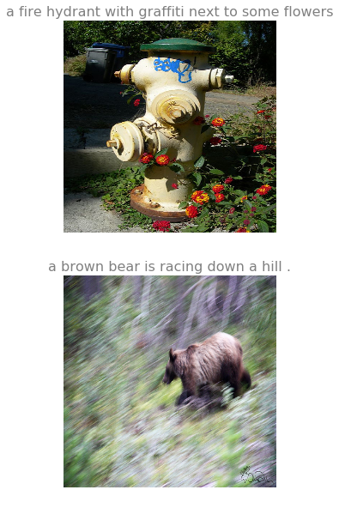
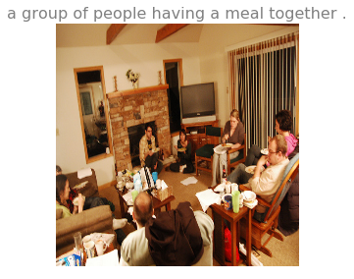
Visualizing the Training Data
Common Objects in Context:
- large-scale object detection, segmentation, and captioning dataset.

Slide 5
Preprocessing
For Images:
Resized
Randomly cropped
Randomly Flipped
Normalized
For Captions:
<Start> and <End> tokens added to captions
Words below threshold count are converted to <Unknown> token
All Captions must have the same length per batch. The sampler is programmed to only obtain sentences with the same length when sampling every batch
Goes into the usual NLP pipeline. Tokenized, Vectorized, Word Embeddings.

Slide 6
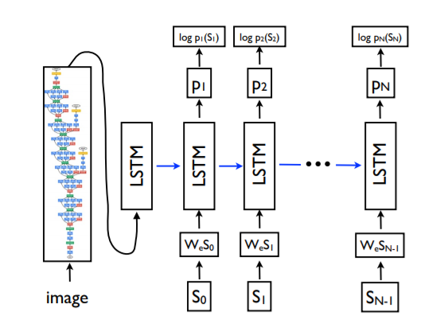
Modelling
An end to end Neural Network model which consist of:
A CNN encoder which translates the image into a fixed length vector representation that is passed in as the initial step for the RNN
A RNN ‘decoder’ which generates the target sentence, one word at a time. LSTM is used in this model.
Ref: A Neural Image Caption Generator

Slide 7
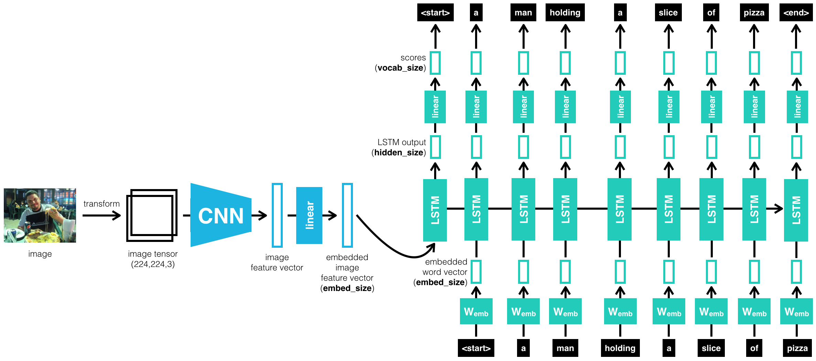
Architecture

Slide 8
Training and Evaluation
Training is performed on:
Tesla P100 GPUs, 16GB
6 Epochs for about ~6 hours due to large dataset (19GB) and RNNs
Evaluation:
How to evaluate the performance of a generated sentence is still an ongoing research as of now
The best evaluation metric so far is BLEU, originally developed for machine translation tasks
It has some major drawbacks, especially when applied to tasks that it was never intended to evaluate.

Slide 9
The Bilingual Evaluation Understudy
A string-matching algorithm that provides basic quality metrics for Machine Translation
BLEU Downsides includes:
Only measures direct word-to-word similarity and similar word clusters in two sentences
There are no consideration of paraphrases or synonyms
"wander" doesn't get partial credit for "stroll," nor does "sofa" for "couch."
N-grams parameter can be set while evaluating BLEU score. Typically 1-4 grams are considered
Example:
Actual: "A large airplane is taking off from the runway."
Generated: "A large airplane is flying through the air on a sunny day ."
Score:
'BLEU-1 Score: 0.38'
'BLEU-2 Score: 0.31'
'BLEU-3 Score: 0.26'
'BLEU-4 Score: 0.20'

Slide 10
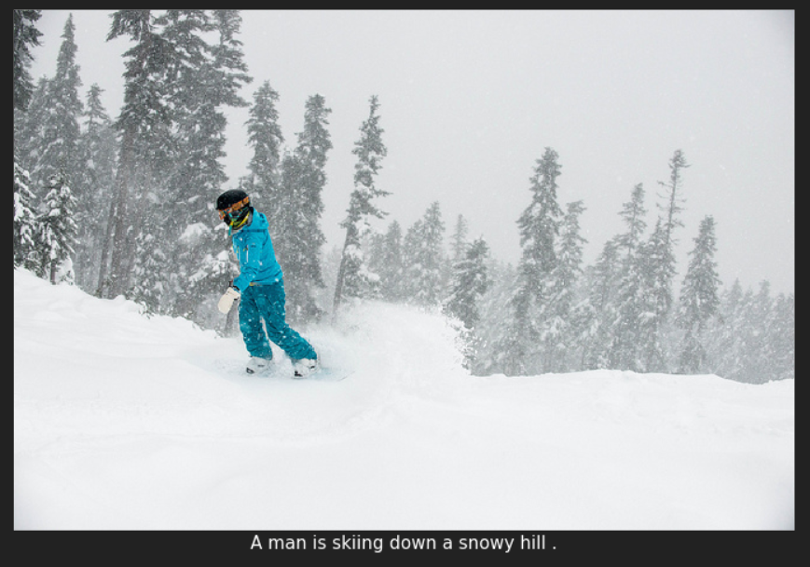
Inference - Good predictions on Val Set

Slide 11
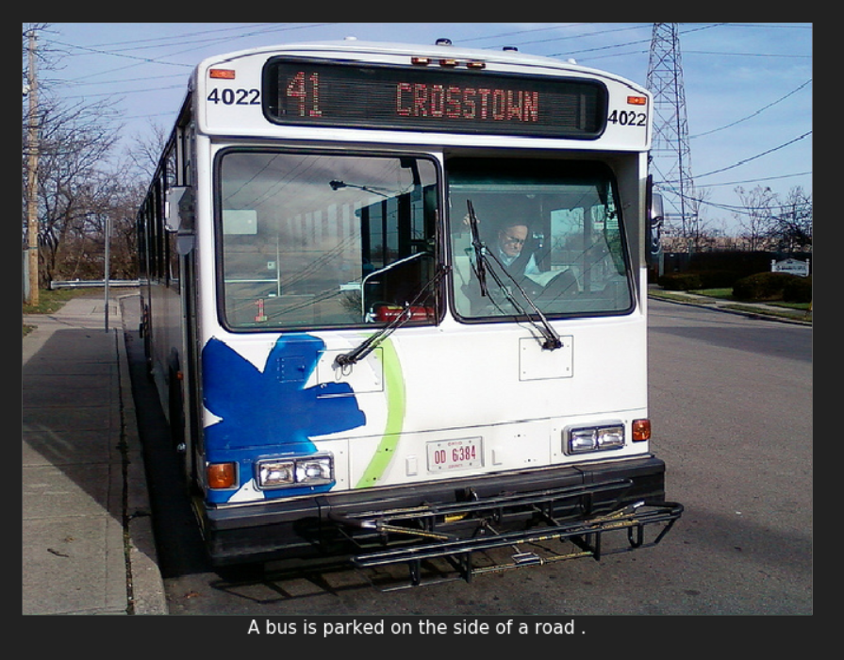
Inference - Good predictions

Slide 12
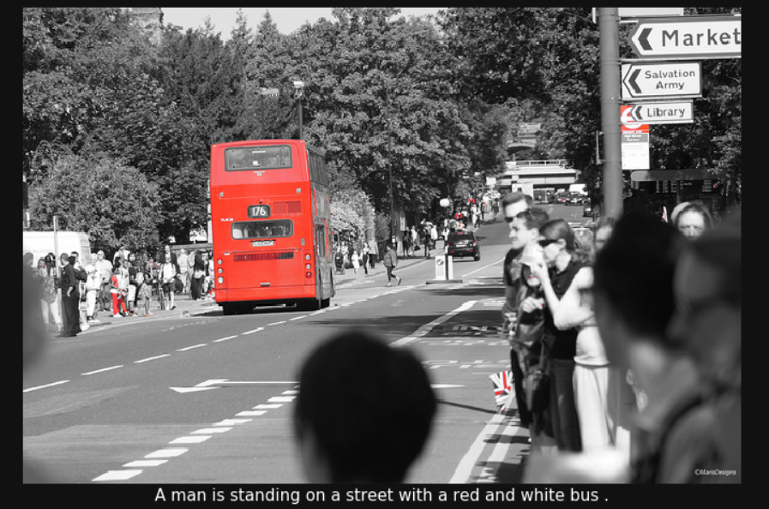
Inference - Good predictions

Slide 13
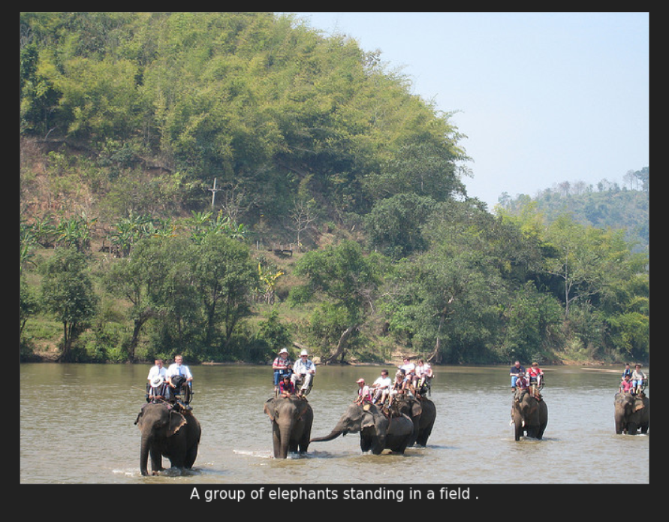
Inference - Good predictions

Slide 14
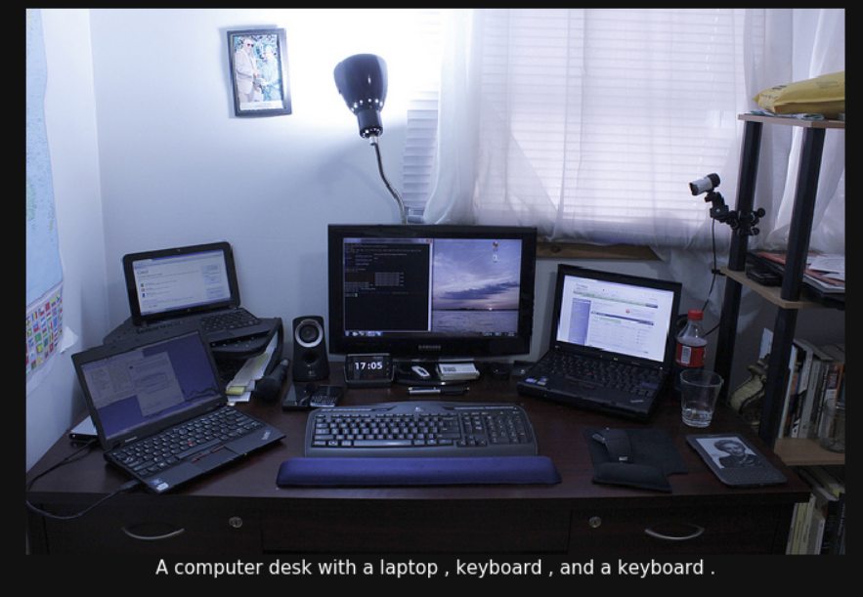
Inference - Good predictions

Slide 15
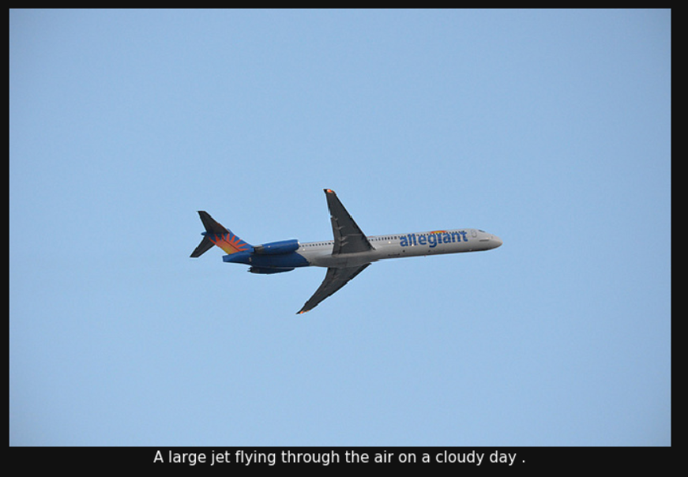
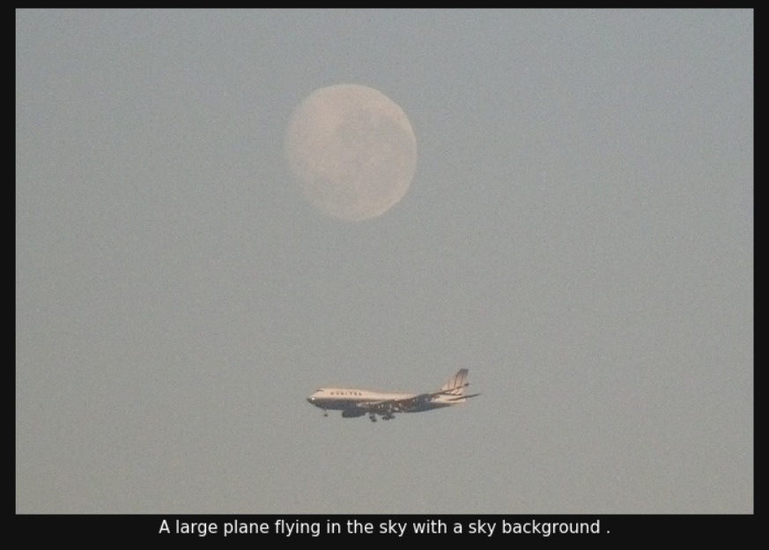
Inference - Good predictions

Slide 16
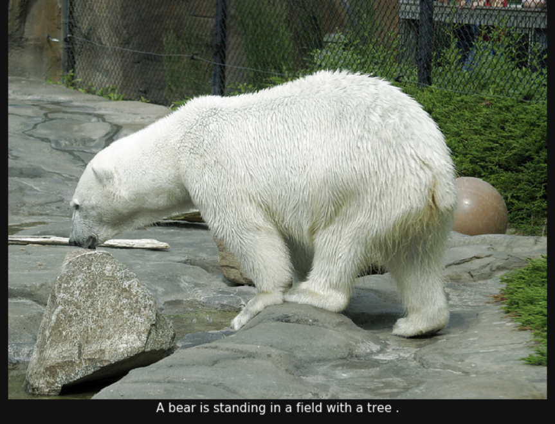
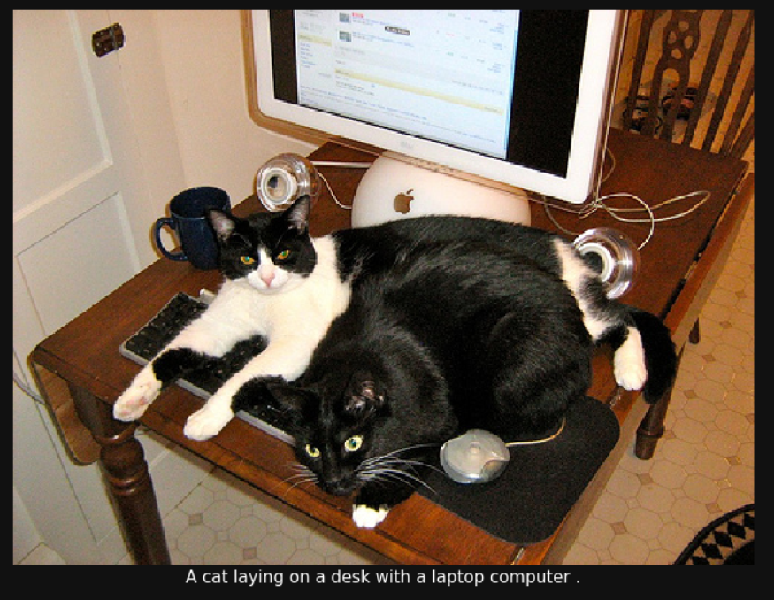
Inference - Good predictions

Slide 17
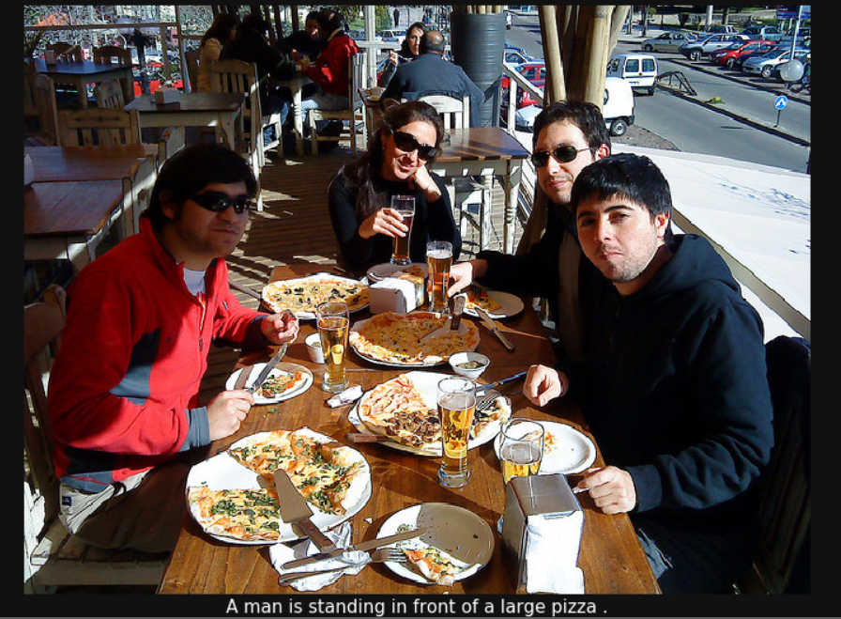
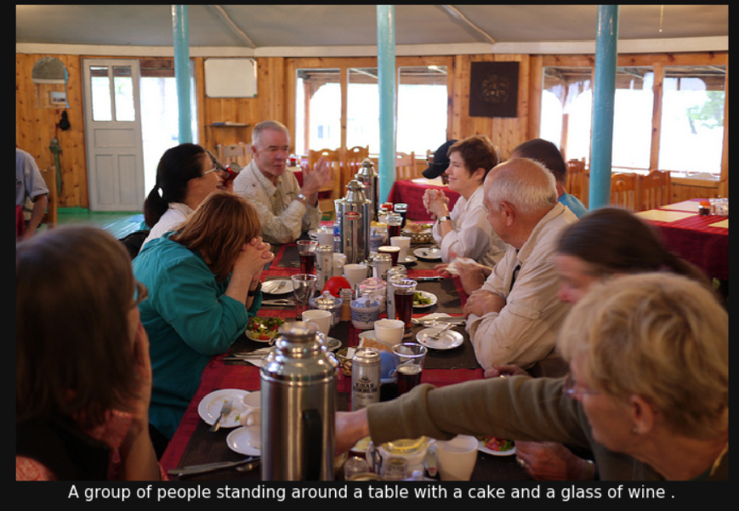
Inference - Good Predictions

Slide 18
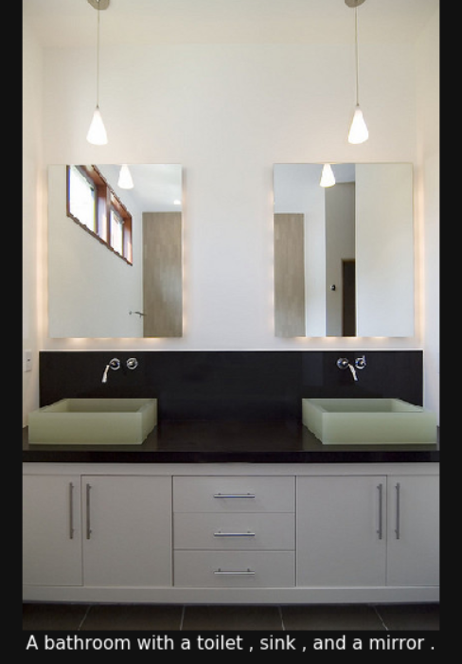
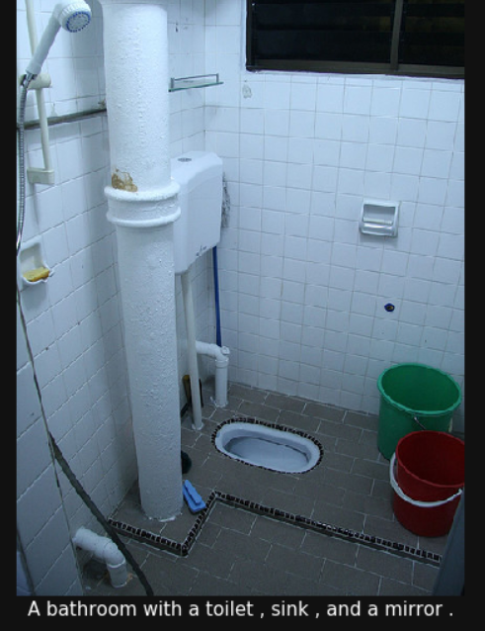
Inference - Average predictions

Slide 19
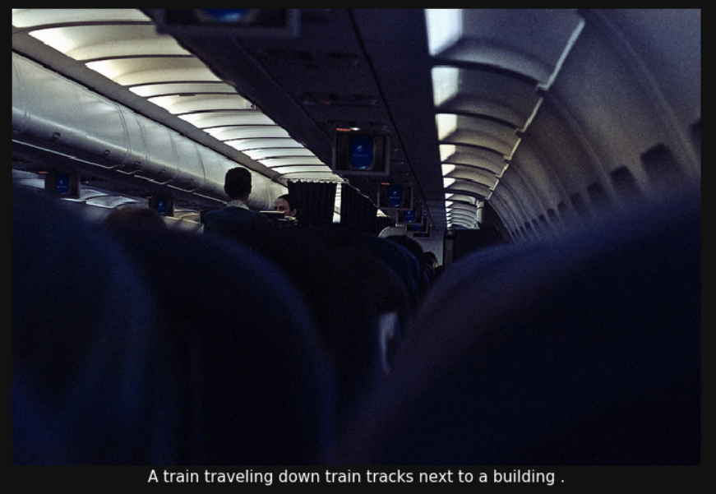
Predictions Not Related to image

Slide 20
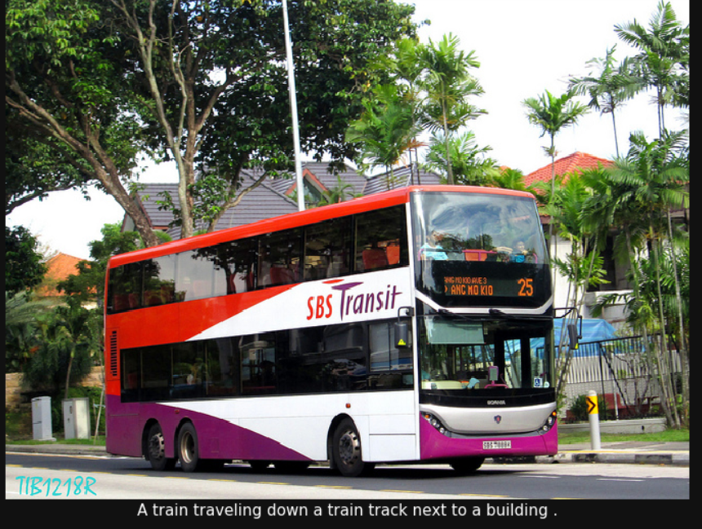
Predictions Not Related to image

Slide 21
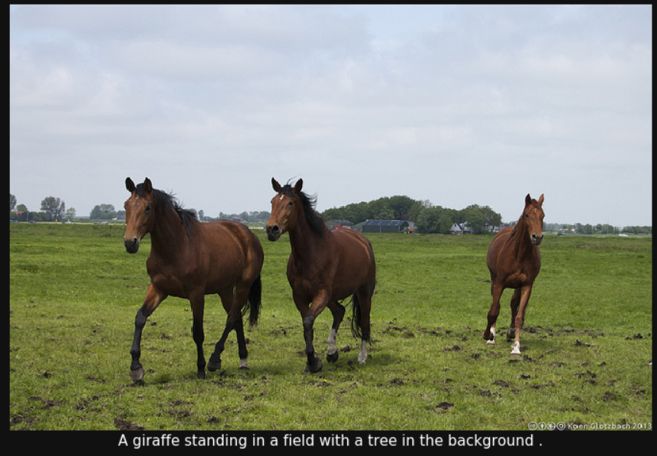
Predictions Not Related to image

Slide 22
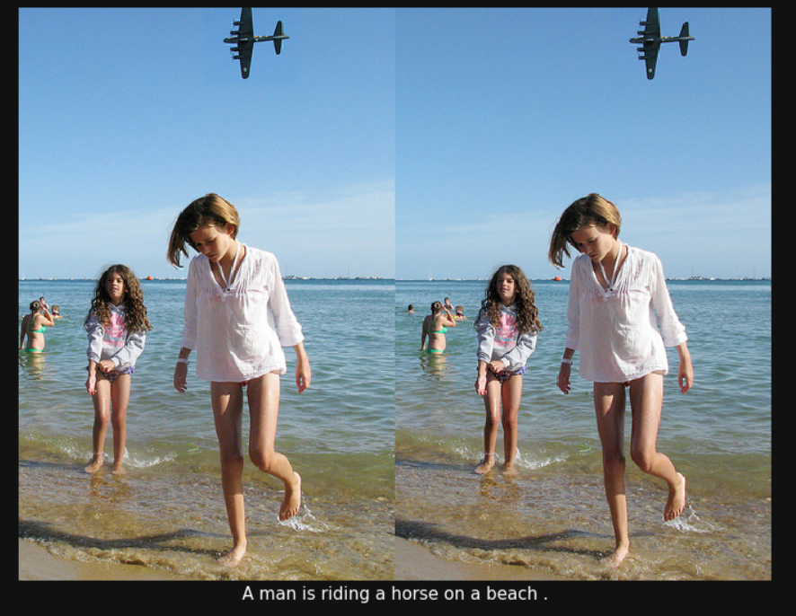
Predictions Not Related to image

Slide 23
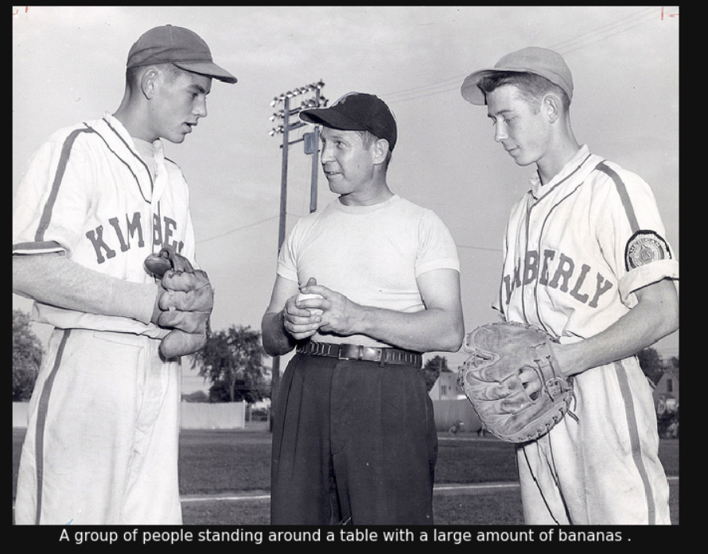
Predictions Not Related to image

Slide 24
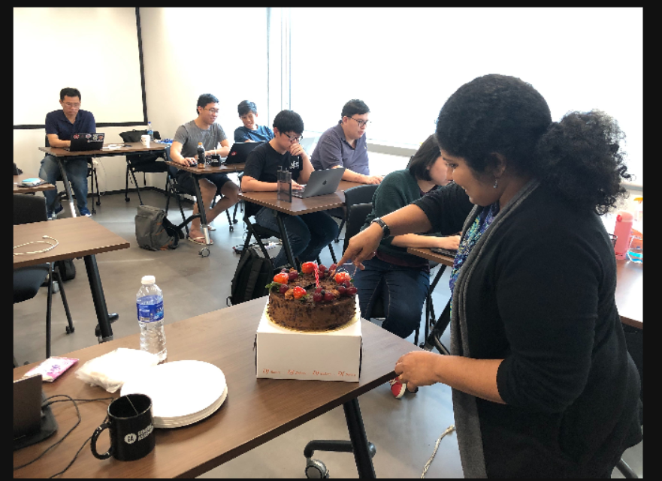
Test Images

Slide 25
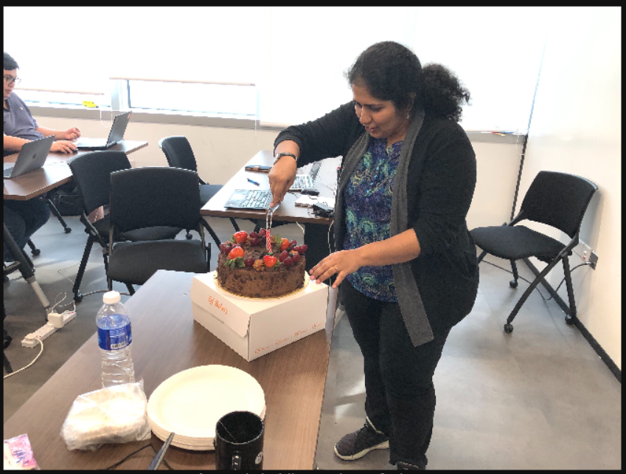
Test Images

Slide 26
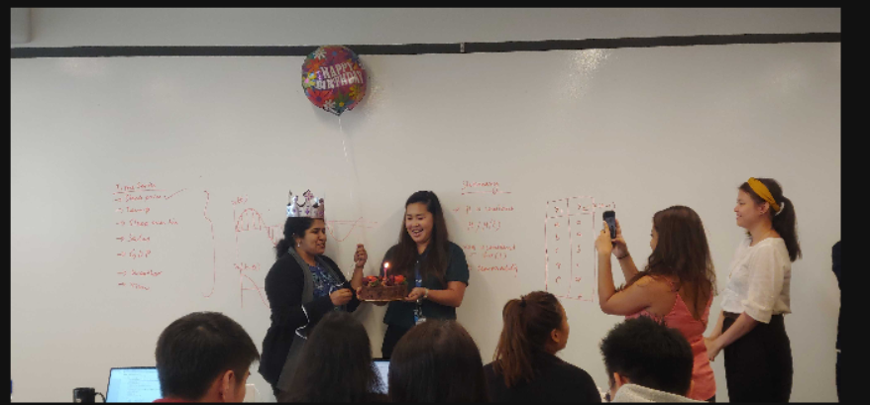
Test Images

Slide 27
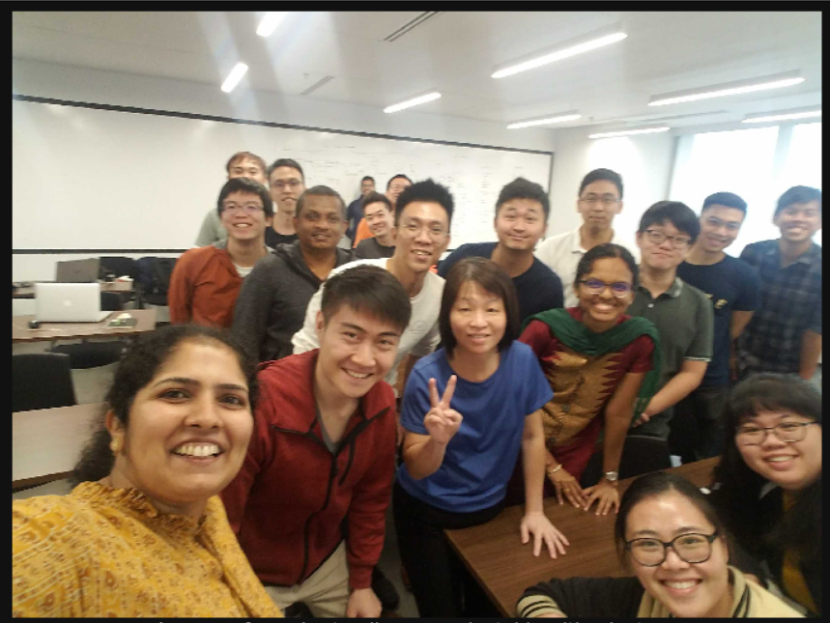
Test Images

Slide 28
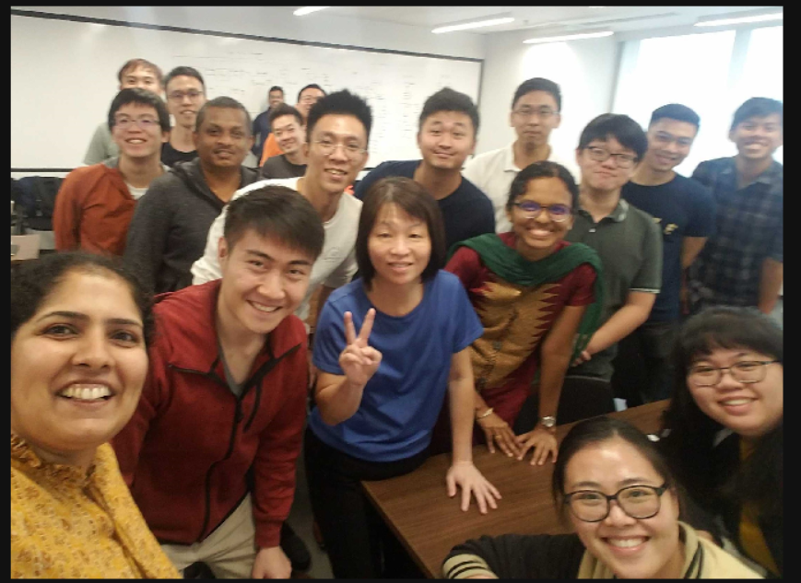
Test Images

Slide 29
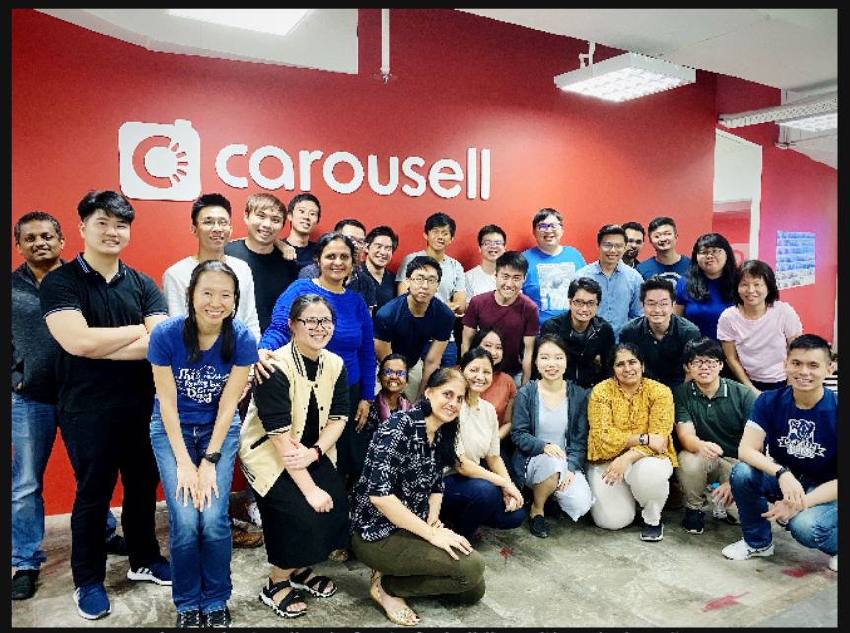
Test Images

Slide 30
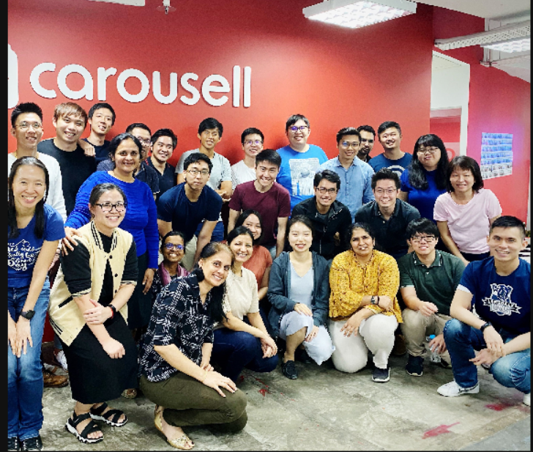
Test Images

Slide 31
Conclusion & Improvements
The model is able to train and works well on images that contains:
Planes, cats, giraffes, laptops, tennis, surfing, skiing, buses, trains, pizza, food, toilet, kitchen, Clocks
Room for improvements:
Gender neutral or provide more examples of different gender
Improve the training captions to be more comprehensive
Model Architecture Improvements
Beam Search
Experimenting with adding more layers after CNN
Try different CNN model architectures (Resnet-50 used here)
Attention

Slide 32
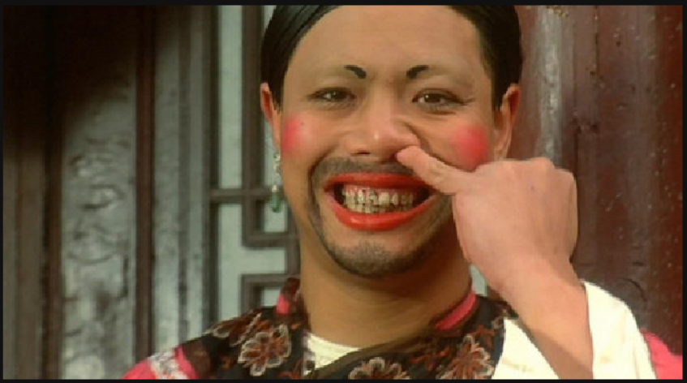
Thank you DSI-10 for the great time!

